Slide 2
Computational approaches for the therapeutic target discovery to ame-liorate muscle wasting during aging and disease
Msc Karen Guerrero Vazquez
Dr. Katarzyna Whysall
Dr. Pilib O Broin

Slide 3
Table of contents
Introduction to the problem
Objective of the project
Differential expression analysis
New database to easer access to microRNA information
Network analysis
Future work

Slide 4
The problem…
1

Slide 5

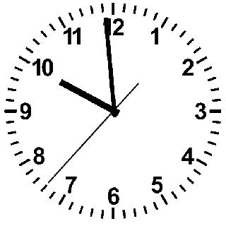
1

Slide 6
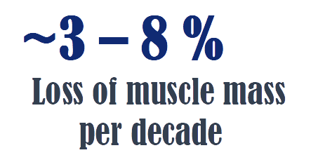
1

Slide 7
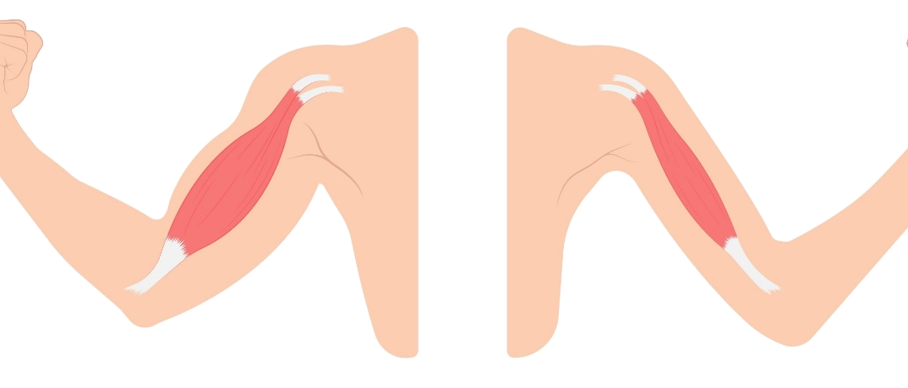
1

Slide 8
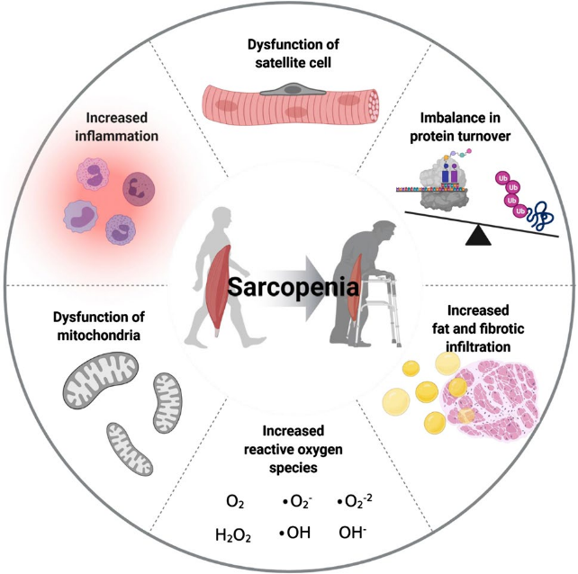
1

Slide 9
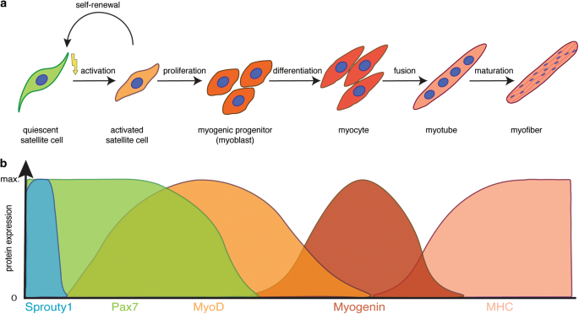
1

Slide 10
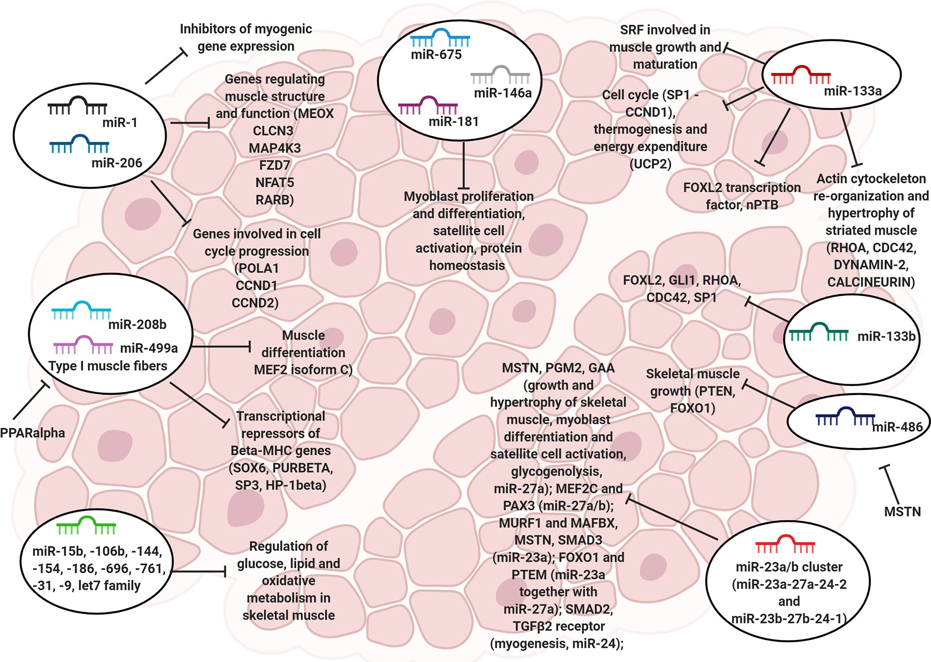

MicroRNA (miRNAs)
1

Slide 11
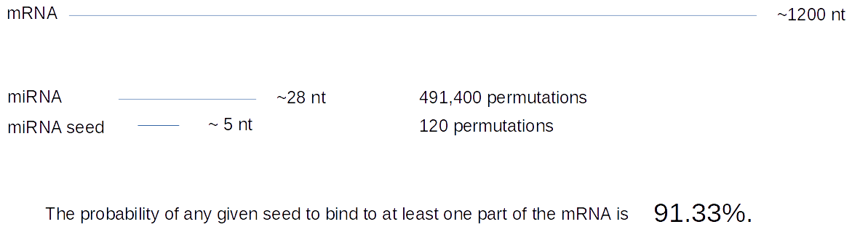
MicroRNA (miRNAs)
1

Slide 12
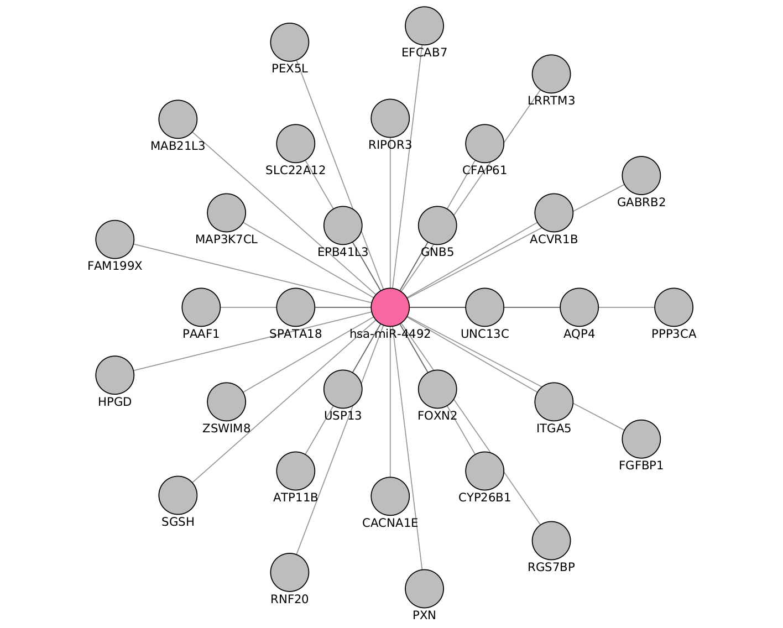
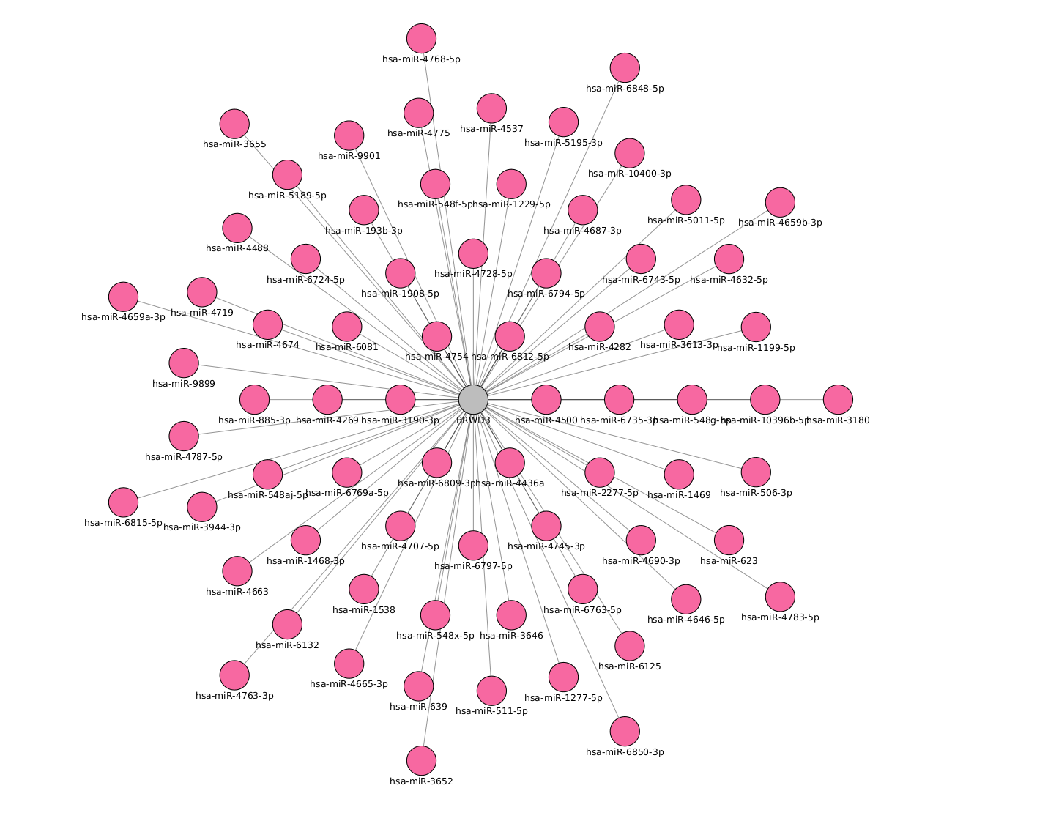
1

Slide 13
Objective
2

Slide 14
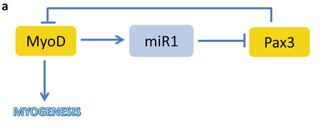
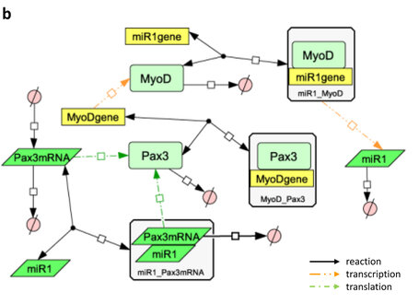
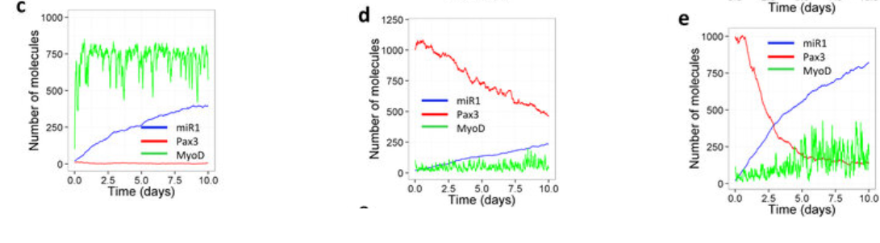
2

Slide 15
What are we going to do to archive this goal?
2
Creation a seed or genes
Recompile the microRNA metadata on a practical accessible way
Integrate the microRNA data with the genes
Select the gene and microRNA players
Generate the model with selected genes and microRNA
Validation

Slide 16
Differential expression analysis
3

Slide 17
3
Target | Type | N.Experiments | Healty | non-healty
mRNA | RNASeq | 3 | 3 | 0
 | MicroArray | 4 | 2 | 2
miRNA | MicroArray | 2 | 2 | 0
 | miRSeq | 1 | 0 | 1

Slide 18
Experiments
3
GEO number | Samples | Min Age | Max Age | Reference
GSE152558 | 5 | 41 | 85 | Tharakan, R., Ubaida-Mohien, C., Piao, Y., Gorospe, M., & Ferrucci, L. (2021).
GSE164471 | 53 | 34 | 80 | Tumasian III, R. A., Harish, A., Kundu, G., Yang, J. H., Ubaida-Mohien, C., Gonzalez-Freire, M., ... & Ferrucci, L. (2021).
GSE157585 | 136 | 19 | >65 | Kulkarni, A. S., Peck, B. D., Walton, R. G., Kern, P. A., Mar, J. C., Windham, S. T., ... & Peterson, C. A. (2020).
GSE87105 | 16 | 30 | 78 | Mercken, E. M., Capri, M., Carboneau, B. A., Conte, M., Heidler, J., Santoro, A., ... & de Cabo, R. (2017)..

Slide 19
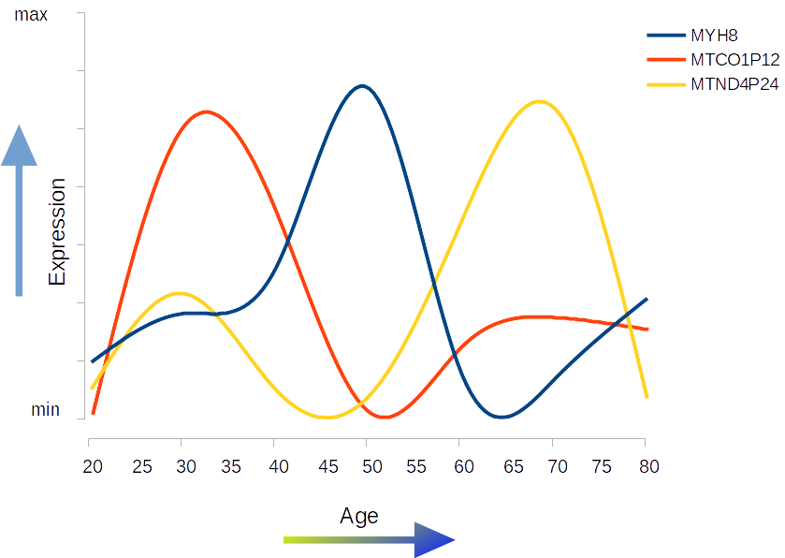



3

Slide 20
Differential expression
3
Quality evaluation: FastQC
Trimming adapters: cutadapt
Pseudo alignment: Kallisto
Mappint to Ensemble: GRCh38.p13 (Genome Reference Consortium Human Build 38)
Analysis: DESeq2
Pathway analysis: gseapy
Adjusted P-value: 0.1
LogFold Change: 1.0

Slide 21
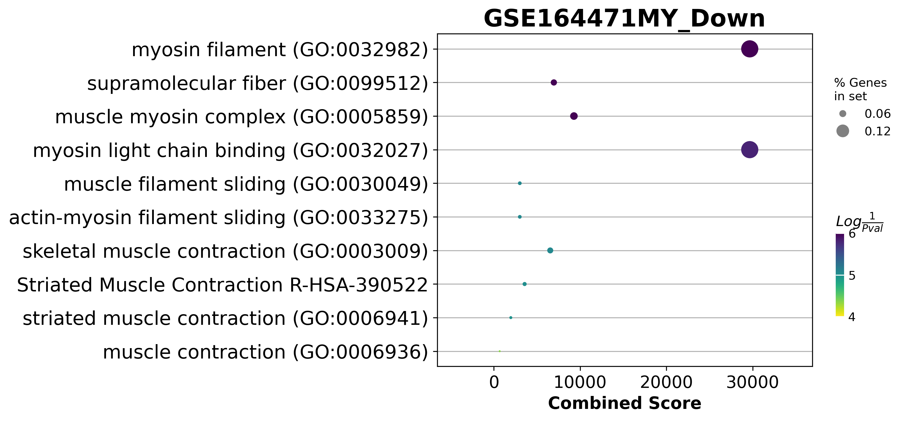
Young to middle age

Slide 22
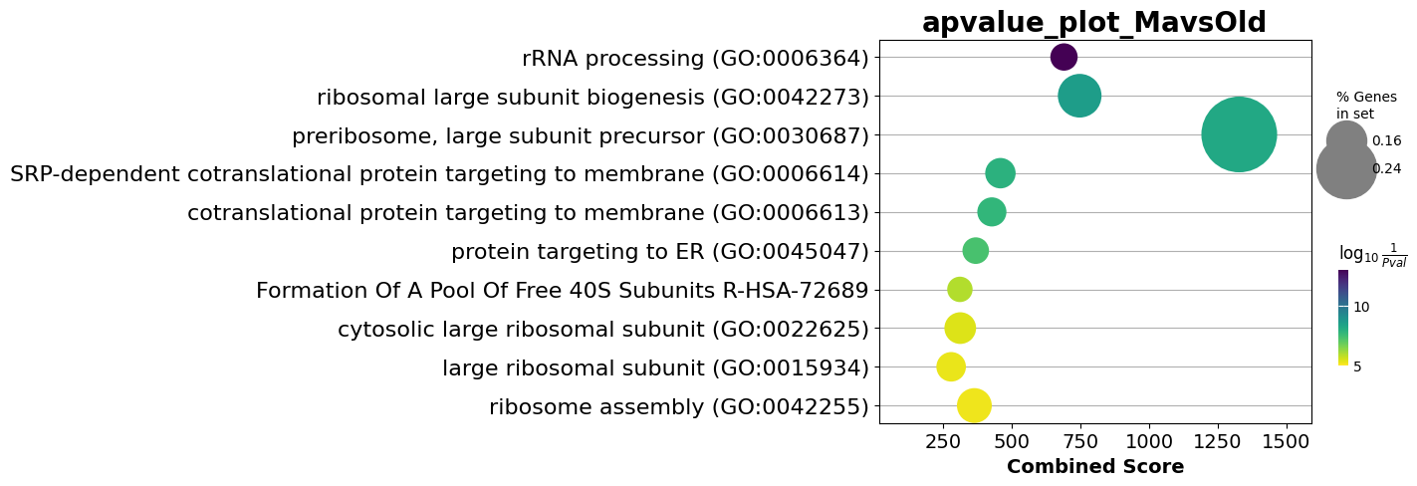

Slide 23
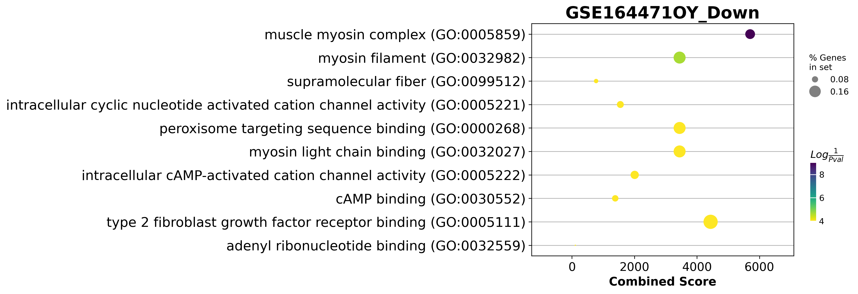
Young vs Old

Slide 24
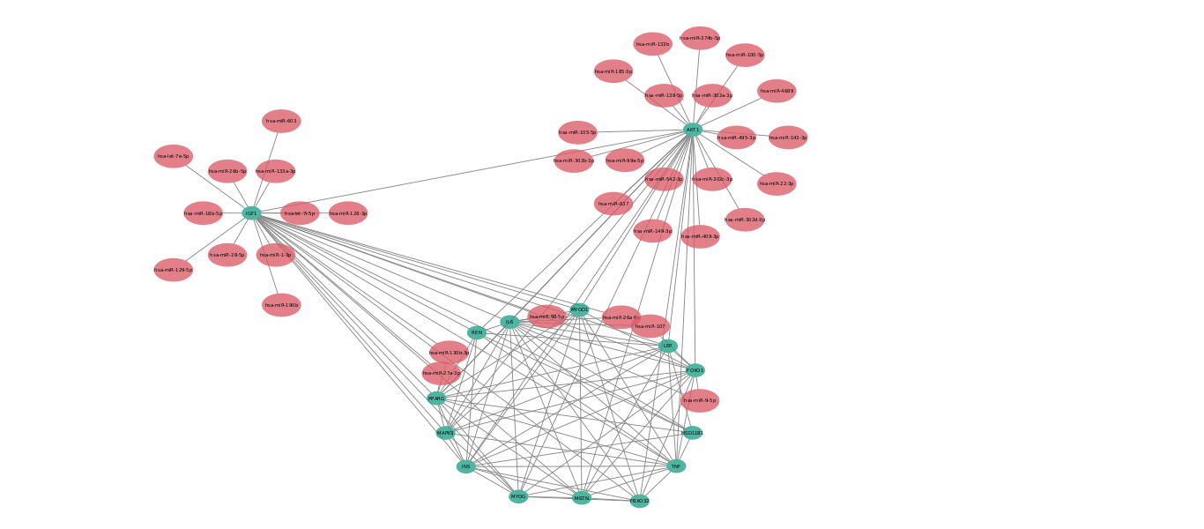
3

Slide 25
Differentially expressed genes
3
Experiment | Evaluation | Regulation | n Genes
GSE152558 | MO | UP | 8
GSE152558 | MO | Down | 9
GSE157585 | YO | UP | 9
GSE157585 | YO | Down | 73
GSE164471 | YO | UP | 5
GSE164471 | YM | UP | 2
GSE164471 | MO | UP | 6
GSE164471 | YO | Down | 8
GSE164471 | YM | Down | 2
GSE164471 | MO | Down | 11
GSE23527 | YO | Up | 1
GSE23527 | YO | Down | 5
GSE875105 | OY | Down | 88
GSE875105 | MO | Up | 6
GSE875105 | OY | Up | 18

Slide 26
What change during aging
3

Slide 27
What is next with this data?
3
Experimental validation

Slide 28
miRKatDB: An integrated resource for microRNA data
4

Slide 29
Current resources
4
Total binding registers: 15,436,301
mirTarBase 7,694
mirWalk 15,428,606
hsa 12,526,887
miRNAs: 5,277
hsa 2673
Combinations miRNAs-Target: 8,800,625

Slide 30
4
Database | year | Cites | PubmedID | Content | Prediction Algorithm | API | API alternative
miRBase | 2014 | 2368 | 24275495 | General | NA | NA | NA
miRWalk | 2011 | 830 | 21605702 | Predicted miRNA | Yes | NA | NA
miRTarBase | 2010 | 563 | 21071411 | General | NA | NA | NA
miRDB | 2020 | 374 | 31504780 | Expression | Yes | NO | Yes
DIANAmiTED | 2022 | 0 | 34469540 | Expression | NA | NA | NA

Slide 31
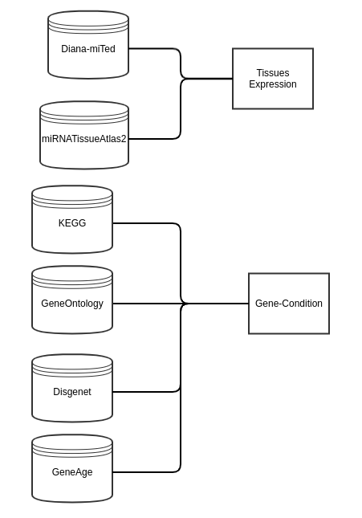
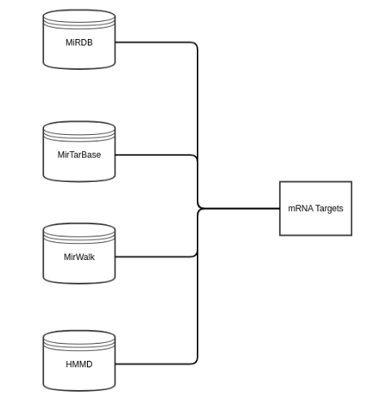
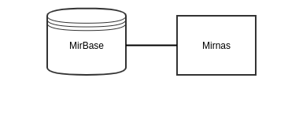
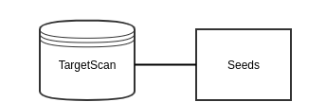
Collection structure
4

Slide 32
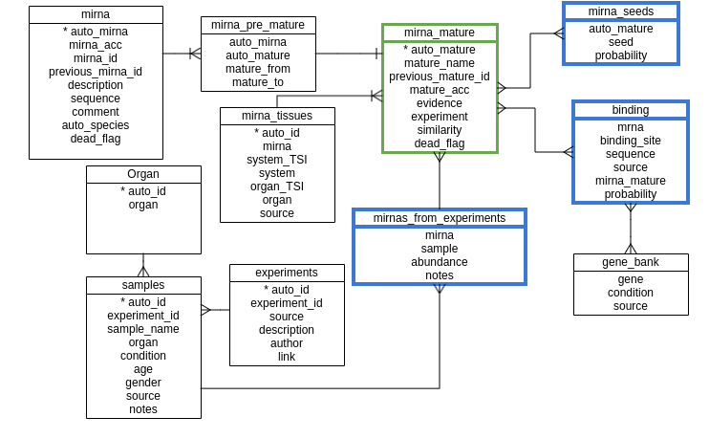
4

Slide 33
Current status of miRKatDB
4
Hosted ___ microRNAs
___ Interactions
___ Databases integrated
Hosted on CloudIX on IP ___

Slide 34
Future work with the database
4
Add __ databases
Add expression or API to call for it from other sites
Add API
Add NLM to ask queries in natural language

Slide 35
Network analysis
5

Slide 36
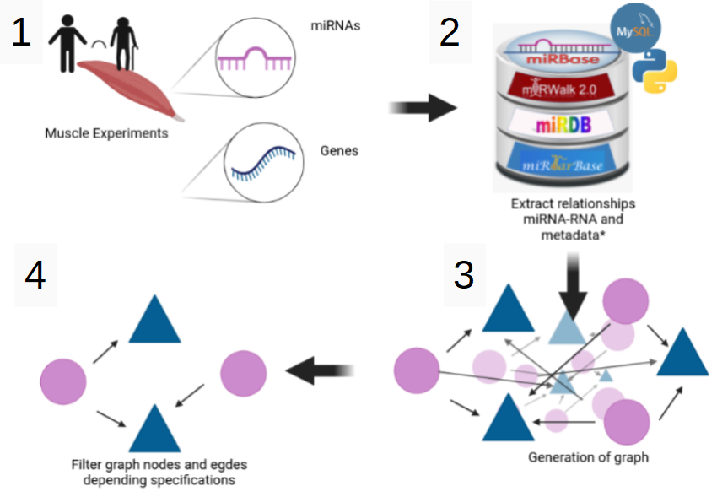
Integration of DE genes and microRNAs
5

Slide 37


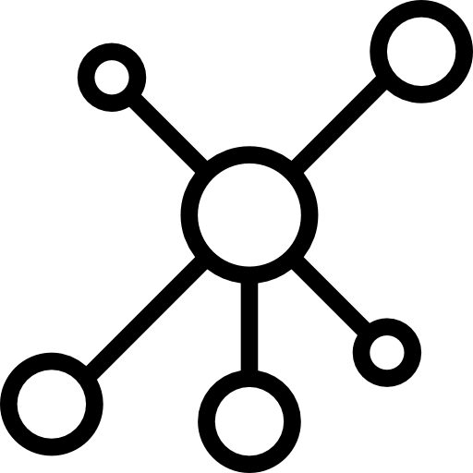
5

Slide 38
State of the art
5
Mirnet

Slide 39
Challenges
5
Selection of microRNAs
Bias on enrichment analysis
Inexistent microRNAs vs undiscovered microRNAs
Evaluation of the network

Slide 40
Approaches taggled
5

Slide 41
Future work
5
Score the networks
Machine learning base network prune
Combine the 3 timeframes on one network along time

Slide 42
Future work
6

Slide 43
Experimental validation on the DE genes
API for access on the Database
Score of the network
Selection of final Genes and MicroRNAs
Generation of model using selected elements in COPASI
Validation of the models.

Slide 44
Conclusions
There had been done a lot in the infrastructure of the project
There are still big challenges to taggle

Slide 45
Thank You

Slide 46
Acknowledgements
This presentation has emanated from research conducted with the financial support of Science Foundation Ireland under Grant number [18/CRT/6214 ]

